Slide 1

ANSWER-IT
Under the Guidance of
MR. GIRISH KULKARNI, ASSISTANT PROFESSOR
Department of Computer Science & Engineering
B V Raju Institute of Technology, Narsapur
Presented by
RAVADA AJAY KUMAR 19211A05N7
SABAVATH GANESH KUMAR 19211A05P6
KOTA NARESH 20215A0520

Slide 2
Abstract
Abstract
Introduction
Modules
Architecture Model
UML / Data Flow/ Flow Chart
Screenshots & Test Cases
Conclusion
Future Enhancement
References
Abstract
Introduction
Modules
Architecture Model
Software/Hardware Requirements
Screenshots
Conclusion
Future Enhancement
References
The project is about developing a Login based Quiz attempting website on important subjects.
Subjects like Data Structures, Database Management System, Java, Python & Aptitude can be chosen to attempt the Quiz.
Time taken to complete the Quiz will be recorded and shown at the end along with wrong and correct answers.
The main purpose of this website is to help student in time management.

Slide 3
Abstract
Introduction
Modules
Architecture Model
UML / Data Flow/ Flow Chart
Screenshots & Test Cases
Conclusion
Future Enhancement
References
Abstract
Introduction
Modules
Architecture Model
Software/Hardware Requirements
Screenshots
Conclusion
Future Enhancement
References
Abstract
Introduction
Existing System
Proposed System
Software requirements
Architecture Model
Modules
UML Diagrams/ER Diagrams/Flow Charts
References
Introduction
First page of website contains Login system for which user need to register first in the website and login to the page using a username and password.
After a Successful login, the user have the option to choose the subject that he/she want to attempt the quiz.
Quiz contain 10 questions with required options and user need to take the quiz, after submission, the total number of correct answers, wrong answers and time taken to the quiz are shown.

Slide 4
Modules
Abstract
Introduction
Modules
Architecture Model
UML / Data Flow/ Flow Chart
Screenshots & Test Cases
Conclusion
Future Enhancement
References
Abstract
Introduction
Modules
Architecture Model
Software/Hardware Requirements
Screenshots
Conclusion
Future Enhancement
References
ANSWER-IT
Login & Registration
System UI
Subject Selection
UI
Basic Quiz UI with a count up Timer
Leader Board UI
Data Base

Slide 5





Architectural Model
Abstract
Introduction
Modules
Architecture Model
UML / Data Flow/ Flow Chart
Screenshots
Conclusion
Future Enhancement
References
Abstract
Introduction
Modules
Architecture Model
Software/Hardware Requirements
Screenshots
Conclusion
Future Enhancement
References
Abstract
Introduction
Modules
Architecture Model
UML / Data Flow/ Flow Chart
Screenshots & Test Cases
Conclusion
Future Enhancement
References
Collect Data
Request
What the user sees & interact with
HTML,CSS,
JavaScript
Response
Display
Contains App Logic :
Python
Users
Web Server
Front End
File System
HTML,CSS,JS, Image Files
Database
MySQL
Back End
Web Application Architecture

Slide 6
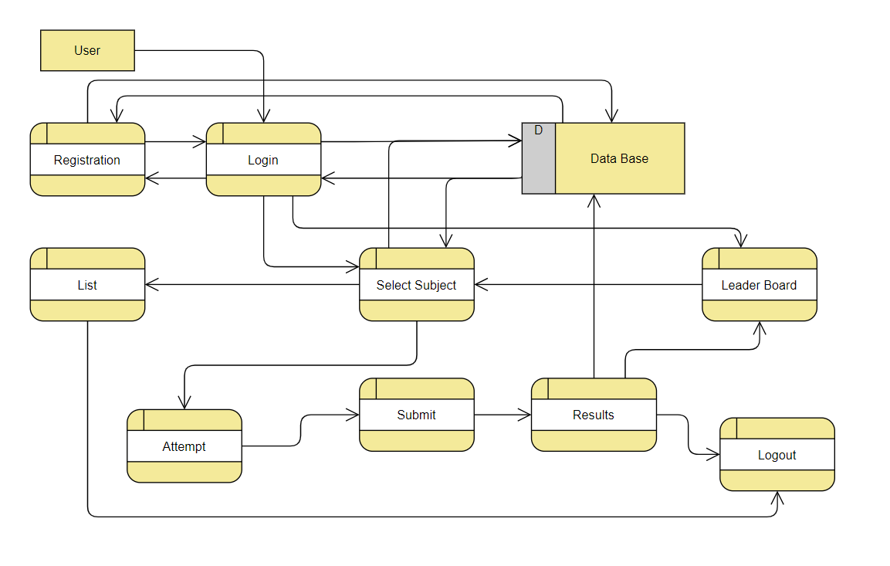
Introduction
Existing System
Proposed System
Software Requirements
References
Abstract
Introduction
Modules
Architecture Model
UML / Data Flow/ Flow Chart
Screenshots & Test Cases
Conclusion
Future Enhancement
References
UML / Data Flow/ Flow Chart
DFD for Online Quiz

Slide 7
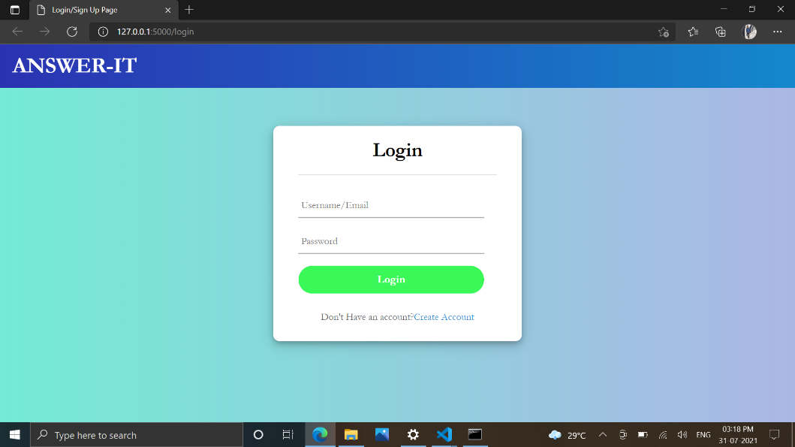
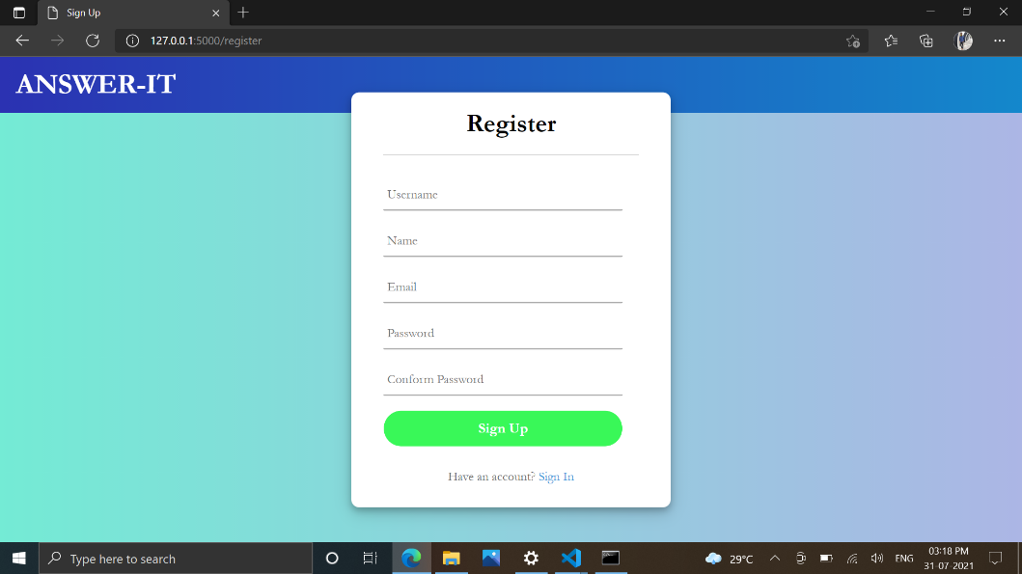
Screenshots & Test Cases
Abstract
Introduction
Modules
Architecture Model
Software/Hardware Requirements
Screenshots & Test Cases
Conclusion
Future Enhancement
References
Registration Page
Login Page

Slide 8
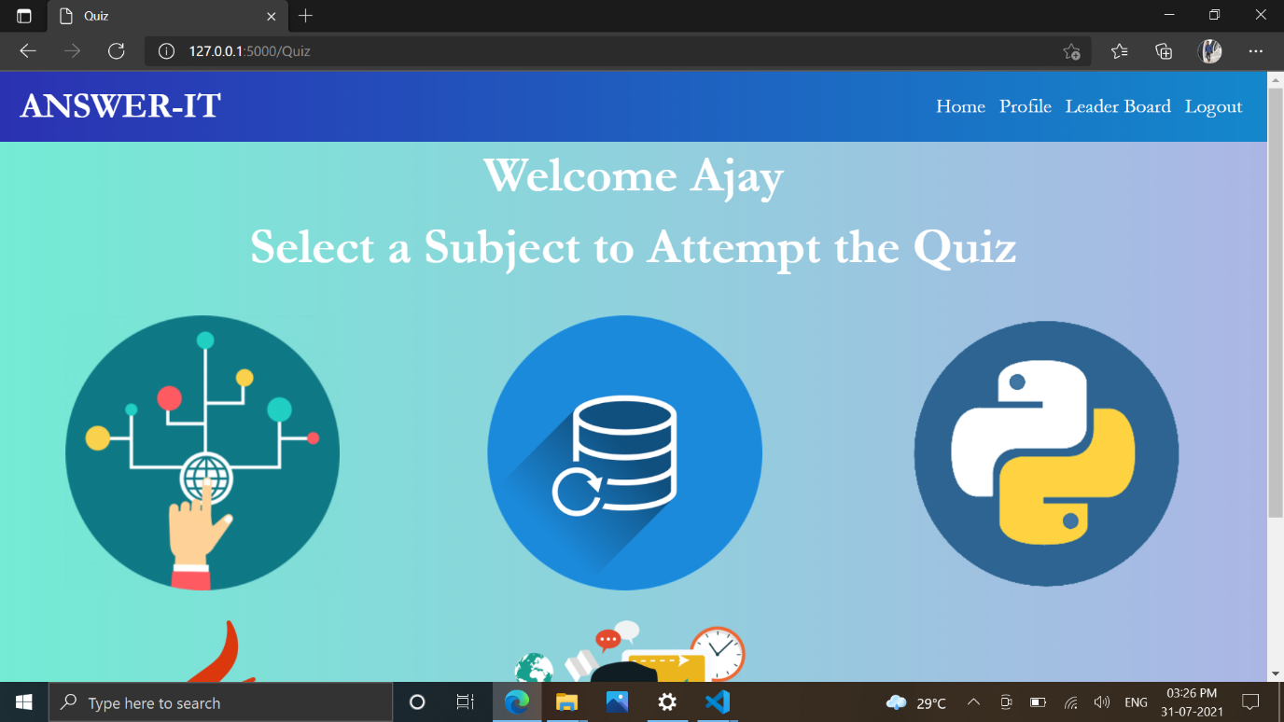
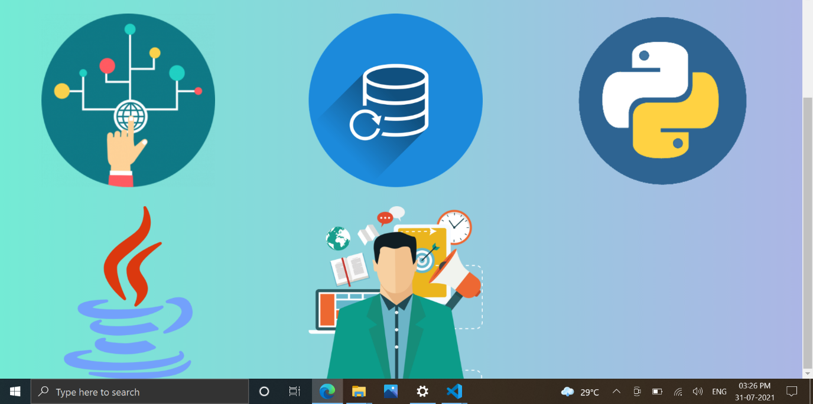
Screenshots & Test Cases
Abstract
Introduction
Modules
Architecture Model
Software/Hardware Requirements
Screenshots & Test Cases
Conclusion
Future Enhancement
References
Subjects Page

Slide 9
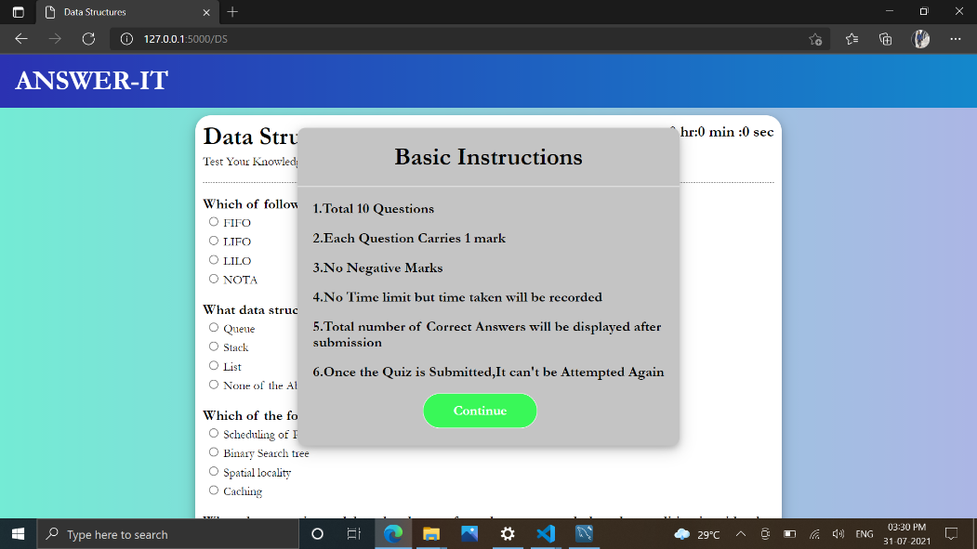
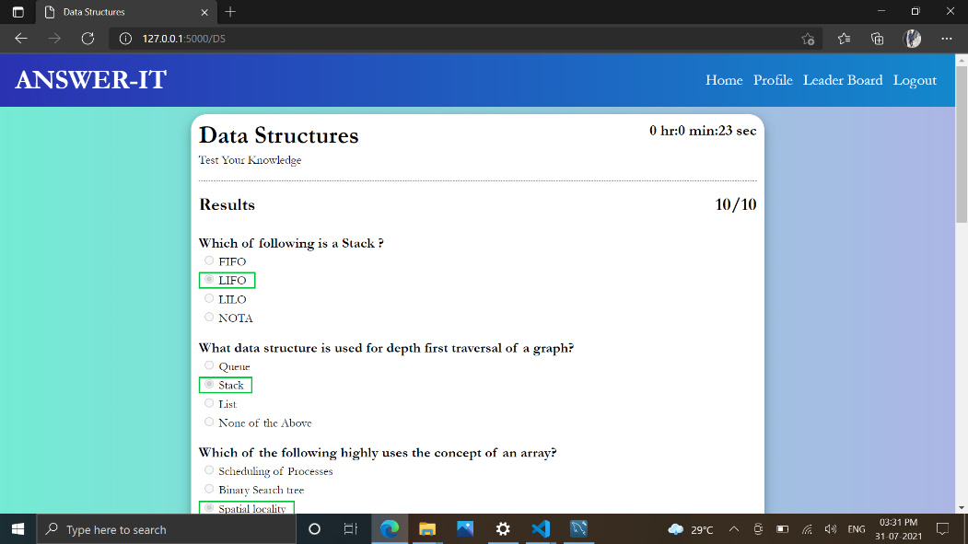
Screenshots & Test Cases
Abstract
Introduction
Modules
Architecture Model
Software/Hardware Requirements
Screenshots & Test Cases
Conclusion
Future Enhancement
References
Quiz(After Submission )
Quiz(Beginning)

Slide 10
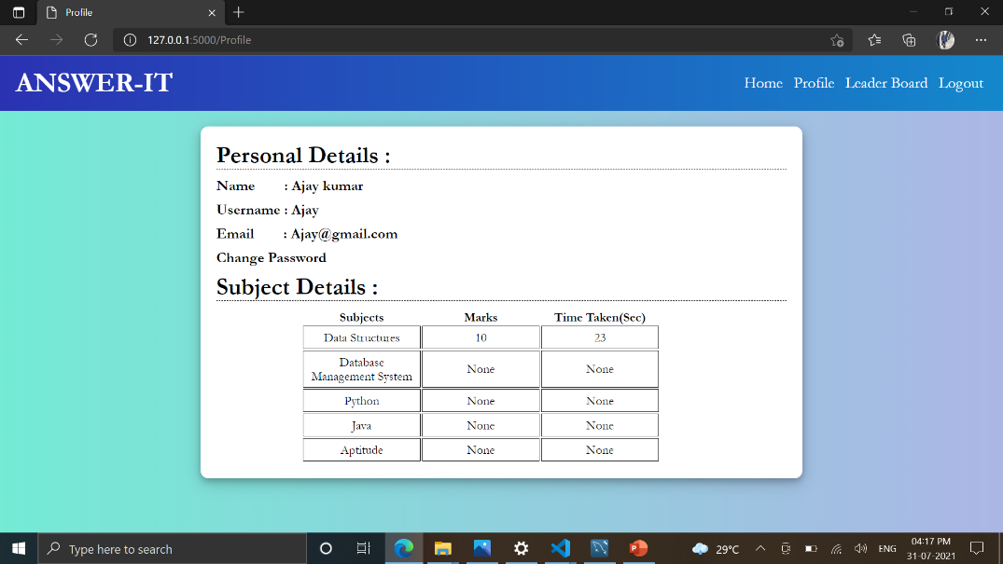
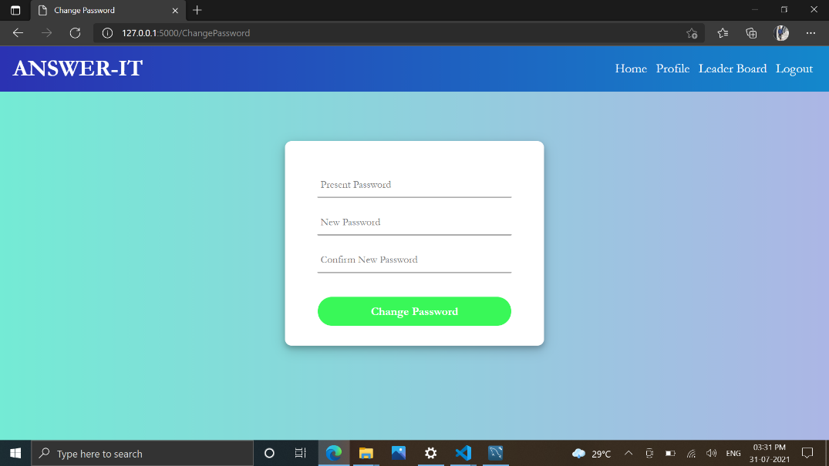
Screenshots & Test Cases
Abstract
Introduction
Modules
Architecture Model
Software/Hardware Requirements
Screenshots & Test Cases
Conclusion
Future Enhancement
References
Change Password
Profile

Slide 11
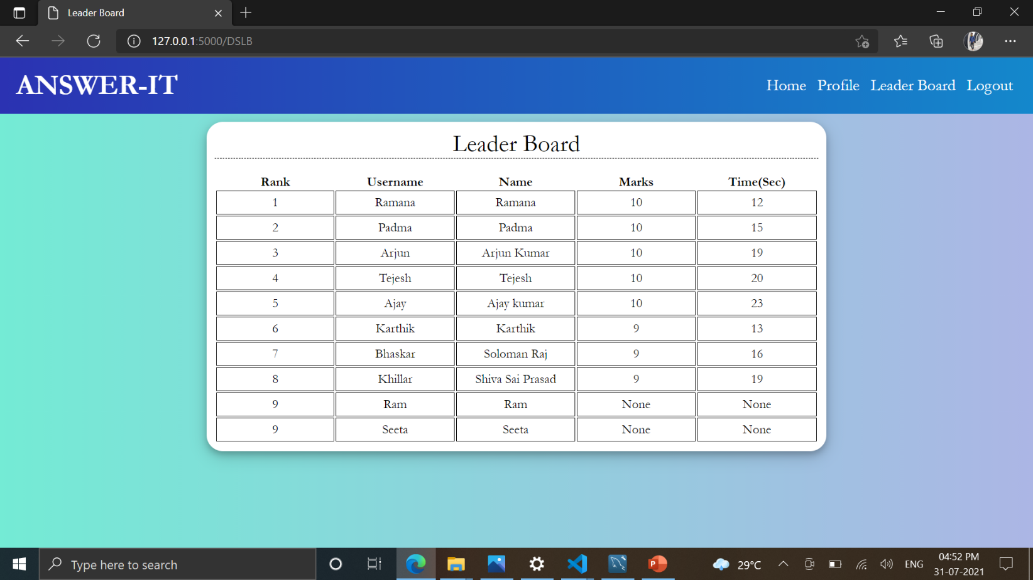
Screenshots & Test Cases
Abstract
Introduction
Modules
Architecture Model
Software/Hardware Requirements
Screenshots & Test Cases
Conclusion
Future Enhancement
References
Leader Board

Slide 12
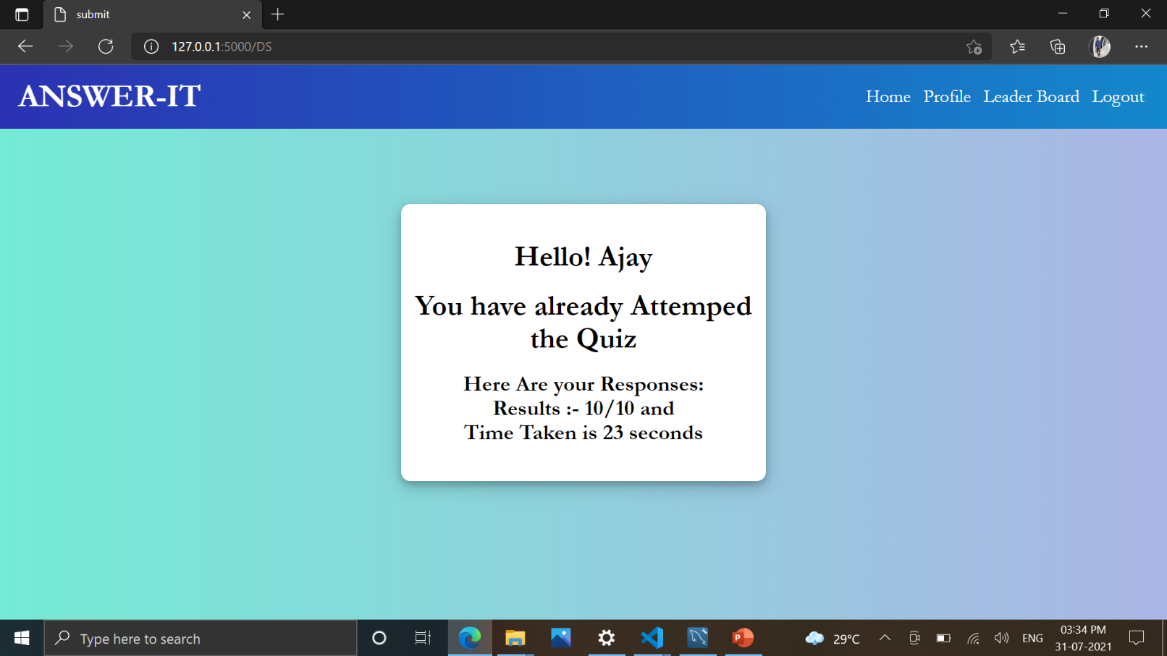
Screenshots & Test Cases
Abstract
Introduction
Modules
Architecture Model
Software/Hardware Requirements
Screenshots & Test Cases
Conclusion
Future Enhancement
References
Trying to Attempt a Subject, which is already Submitted

Slide 13
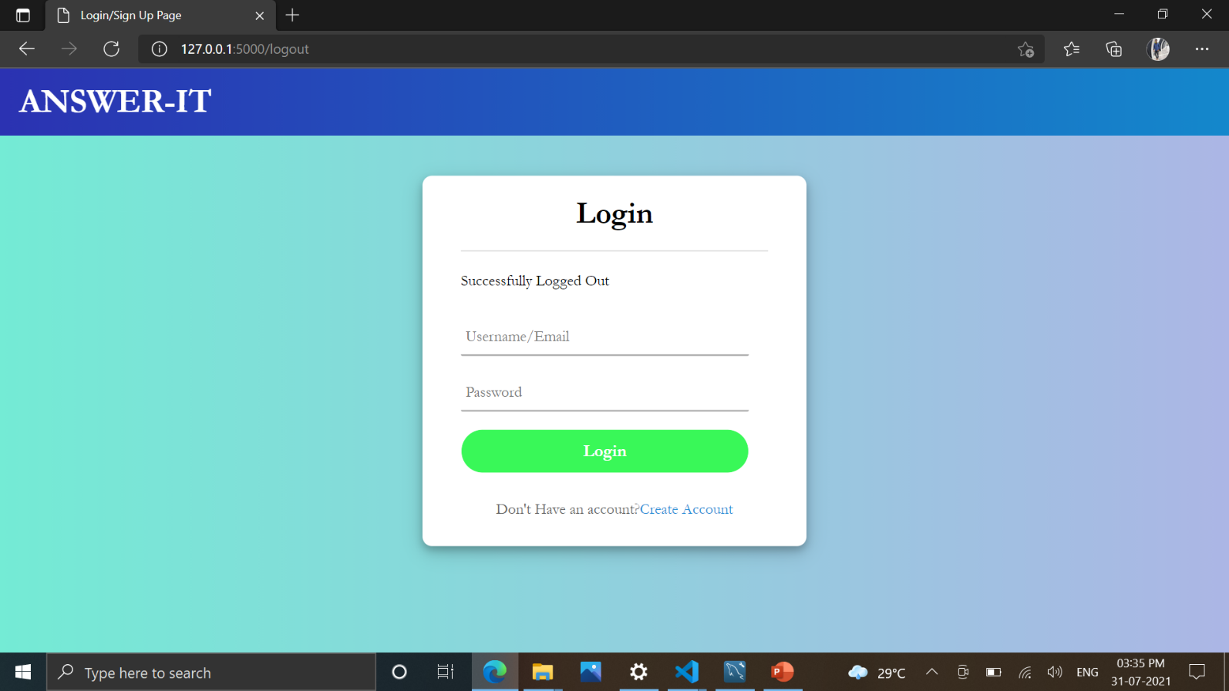
Screenshots & Test Cases
Abstract
Introduction
Modules
Architecture Model
Software/Hardware Requirements
Screenshots & Test Cases
Conclusion
Future Enhancement
References
Logout

Slide 14


Screenshots & Test Cases
Abstract
Introduction
Modules
Architecture Model
Software/Hardware Requirements
Screenshots & Test Cases
Conclusion
Future Enhancement
References
Incorrect Password
Invalid UserId

Slide 15
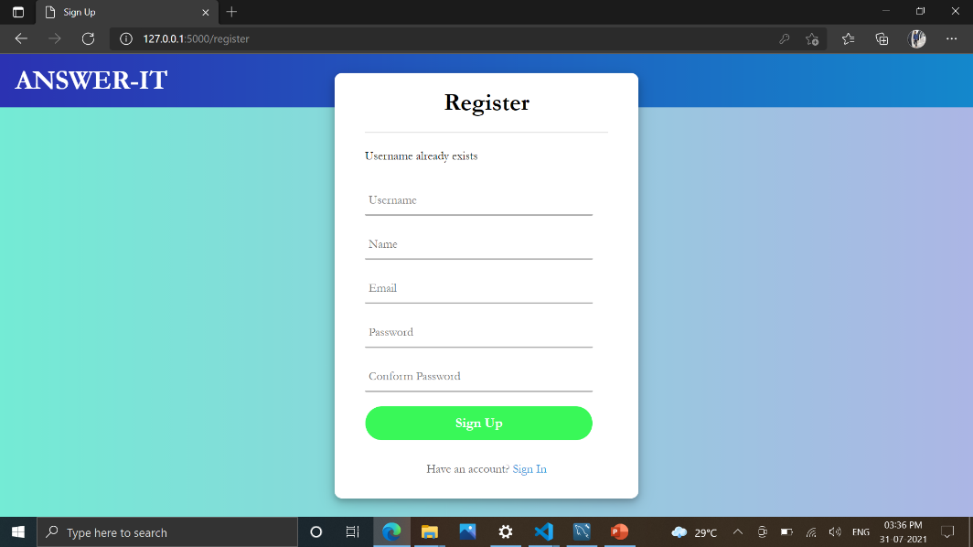

Screenshots & Test Cases
Abstract
Introduction
Modules
Architecture Model
Software/Hardware Requirements
Screenshots & Test Cases
Conclusion
Future Enhancement
References
Password Mismatch
User Exists

Slide 16
Conclusion
Abstract
Introduction
Modules
Architecture Model
Software/Hardware Requirements
Screenshots
Conclusion
Future Enhancement
References
This Application helps in managing the time.
Most of the Subjects covered here, it helps the users in need-not to switch between the websites.
It contains Login system, so User profile will be Secure.

Slide 17
Future Enhancement
Abstract
Introduction
Modules
Architecture Model
Software/Hardware Requirements
Screenshots
Conclusion
Future Enhancement
References
Since Bootstrap is not included, It is not compatible for mobile, so We can make it compatible for mobile for future.
We can add Sets to each subject, so that it helps students in practicing.
We can also include more subjects in the Website.

Slide 18



Introduction
Existing System
Proposed System
Software requirements
References
Abstract
Introduction
Modules
Architecture Model
Software/Hardware Requirements
Screenshots
Conclusion
Future Enhancement
References
References
HTML Tutorial (w3schools.com)
CSS Tutorial (w3schools.com)
JavaScript Tutorial (w3schools.com)
GeeksforGeeks | A computer science portal for geeks
CodeShack - Resource Website for Developers & Designers
YouTube
2/1

Slide 19
Q and A?
?

